Slide 1
Personnel Development Program Data Collection System (PDPDCS) polly maccini, OSEP Aaron Petrillo, Anlar AMAnda PIErce, Westat
January 22, 2019

Slide 2
Training Agenda
Review important components of the PDPDCS including scholar agreements
Describe required actions for data submission
Discuss changes to the PDPDCS
Present the resources available to you and your scholars
Notes:
Please type your questions directly into the chat box. Thank you!

Slide 3
Important PDPDCS Reminders

Slide 4
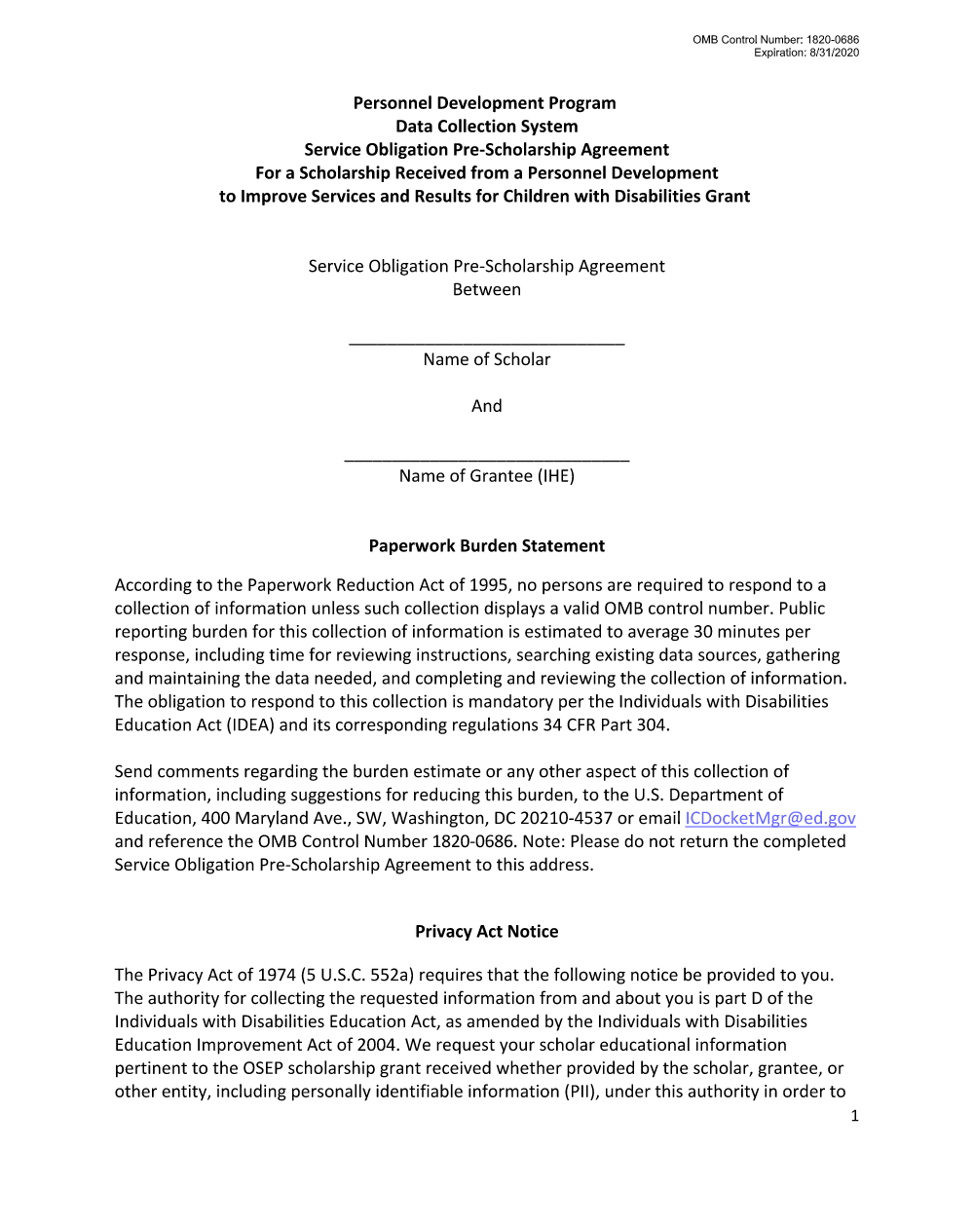
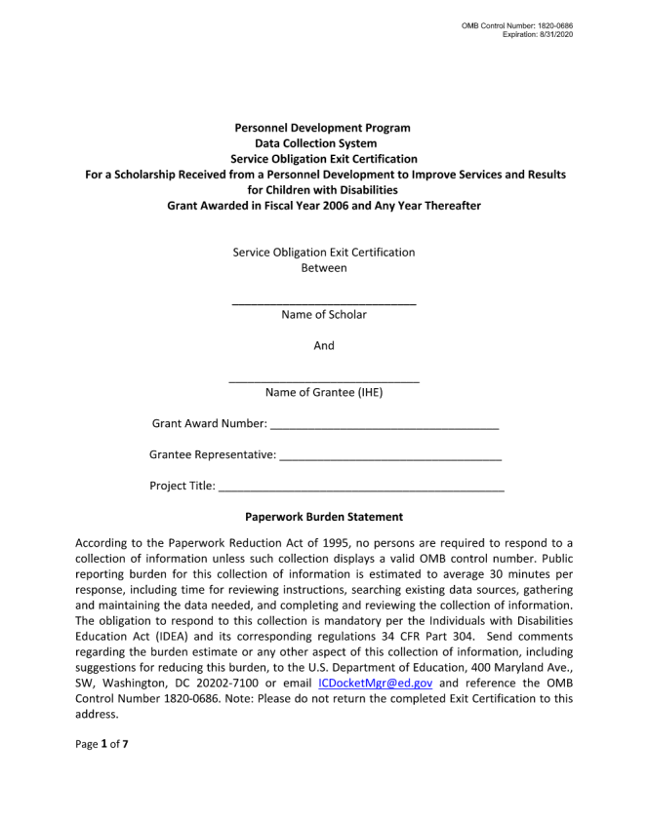
Pre-scholarship Agreements (PSA) and Exit Certifications (EC)
Grantees must upload a completed and signed Pre-Scholarship Agreement and Exit Certification for each scholar who receives funding.
Grantees must use the most recent version of each agreement: OMB Control Number 1820-0686 Expiration: 8/31/2020.
These agreements are found at https://pdp.ed.gov/OSEP/Home/Agreements/.
Notes:
According to Section § 304.23 of the 2006 Regulations grantees are required to provide scholars with Pre-Scholarship Agreements and Exit Certifications outlining the terms and conditions of the Personnel Development Program grant funding.
OSEP developed standard pre-scholarship agreements and exit certification templates because in the past some scholars were not been provided pre-scholarship agreements or exit certifications or the agreements/certifications were vague or inaccurate. Grantees are responsible for the accuracy and maintenance of these documents for funded scholars. To supplement the pre-scholarship agreements and exit certifications, grantees must also disseminate copies of the regulations/requirements and frequently asked questions (FAQs), to scholars.
Grantees must be using the approved OMB forms found on the website in the “Pre-Scholarship Agreements and Exit Certifications” section - https://pdp.ed.gov/OSEP/Home/Agreements
Later in the presentation we will describe future enhancements to the PDPDCS, allowing you to complete both agreements digitally.

Slide 5
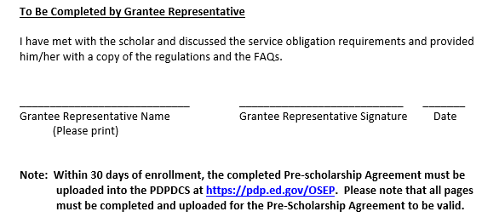
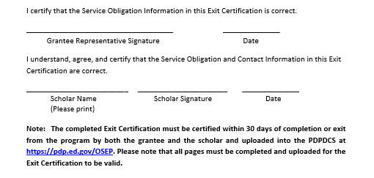
Pre-scholarship Agreements (PSA) and Exit Certifications (EC) (cont.)
Note the instructions for uploading the documents into the PDPDCS
Pre-Scholarship Agreement
Exit Certification
Notes:
As a reminder, there are requirements for when each agreement must be uploaded:
PSA: The pre-scholarship agreement must be completed and uploaded within 30 days of the scholar’s enrollment
EC: The exit certification must be completed and uploaded within 30 days of the scholar’s completion or exit from the program

Slide 6
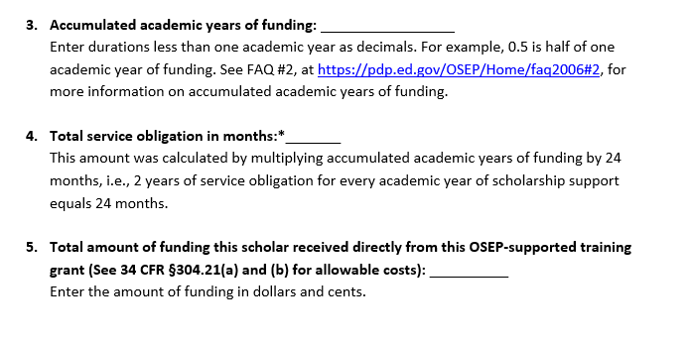
Pre-scholarship Agreements (PSA) and Exit Certifications (EC) (cont.)
Instructions for completing Exit Certification items 3, 4 and 5
Notes:
Within the EC, we have provided instructions to items 3, 4, and 5 to clearly define the information required:
Item 3 defines the accumulated academic years and how to define durations less that one academic year
Item 4 defines the calculation required to determine the total service obligation of the scholar. This is the number of academic years of funding by 24 months
Item 5 clarifies the total amount of funding for the scholar and the regulation citation to define allowable costs

Slide 7
Pre-scholarship Agreements (PSA) and Exit Certifications (EC) (cont.)
 | Pre-Scholarship Agreements | Exit Certifications
When do scholars and grantees sign the agreement? | Upon officially enrolling in the grant supported program, sign and complete a PSA. | Upon scholar’s exit from the program, sign and complete an EC.
When do I upload the agreement? | Upload within 30 days of the scholar’s enrollment. | Upload within 30 days of the scholar’s exit.
What should I check prior to uploading? | Ensure you are using the correct version (OMB Control Number: 1820-0686 Expiration: 8/31/2020), All pages are included, All entries are written legibly and the forms are signed by both the scholar and grantee, and Social security numbers are redacted.
Notes:
In the past we have found this chart as a helpful tool for you and your grant’s staff as a brief reminder of the requirements of each agreement.

Slide 8

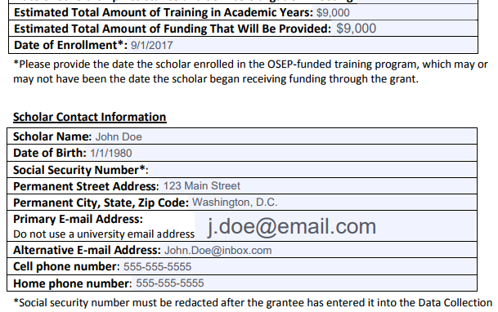
Pre-scholarship Agreements (PSA) and Exit Certifications (EC) (cont.)
Grantees will not be able to submit scholar records without these documents.
Grantees should review to ensure the scholar’s SSN is redacted.
Grantees may be responsible for repayment of grant funds in cases where they do not have a valid signed PSA and EC for a scholar.
Notes:
Remember, you will not be able to submit the scholar record without providing the appropriate scholar agreements.
Prior to uploading agreements, grantees must ensure the agreements are signed and scholars’ names should match what’s in the PDPDCS. Prior to uploading the agreements, SSNs should be redacted on the PSA and EC after you enter the SSN in the system.
Invalid agreements (including those that are not signed or do not match the information provided in the scholar record) could result in the grantee being responsible for repayment

Slide 9

What do I need to tell my scholars about their service obligation?
Clearly explain the following to your scholars before they accept funding:
Exiting prior to one academic year of enrollment requires a cash payback (no option for fulfillment through service)
After one academic year scholars may begin fulfilling their obligation through service
Log into the PDPDCS and submit eligible employment information to receive credit towards their service obligation
Update employment information annually
Notes:
Exiting prior to one academic year of enrollment in program requires a cash payback (no option for fulfillment through service if exiting prior to one academic year)
In addition to the PSAs and ECs, you must disseminate to scholars copies of the current regulations, 34 CFR part 304, and the frequently asked questions (FAQs). Scholars also have certain requirements they must fulfill if they accept funding. Please explain clearly to your scholars before they agree to accept funding their service obligation requirements and continue to remind scholars throughout the program about the requirements and that they will need to submit employment information.
The performance measures based on employment data reported by the scholars have suffered in recent years because scholars are not logging into the DCS and submitting their employment information. You know and see your scholars so please remind them that once they receive the email with instructions for accessing the PDPDCS (which is sent to them as soon as you submit their record in the system) they should login. Scholars must complete 1 academic year before they may begin to fulfill their obligation through service. Scholars employed in eligible positions should enter employment information so that there is complete and high-quality data to report for the performance measures and the scholars can receive credit towards their service obligation. Scholars who do not submit eligible employment information that is verified by their employer by the time their service obligation must be fulfilled are not in compliance and will be referred to the Debt and Payment Management Group for repayment.

Slide 10
What do I need to tell my scholars about their service obligation?
Scholars who do not submit eligible employment information verified by their employer by the time their service obligation must be fulfilled are not in compliance and will be referred to Accounts Receivable and Bank Management Group (ARBMG) for repayment.
Notes:
In addition to the PSAs and ECs, you must disseminate to scholars copies of the current regulations, 34 CFR part 304, and the frequently asked questions (FAQs). Scholars also have certain requirements they must fulfill if they accept funding. Please explain clearly to your scholars before they agree to accept funding their service obligation requirements and continue to remind scholars throughout the program about the requirements and that they will need to submit employment information.
The performance measures based on employment data reported by the scholars have suffered in recent years because scholars are not logging into the DCS and submitting their employment information. You know and see your scholars so please remind them that once they receive the email with instructions for accessing the PDPDCS (which is sent to them as soon as you submit their record in the system) they should login. Scholars must complete 1 academic year before they may begin to fulfill their obligation through service. Scholars employed in eligible positions should enter employment information so that there is complete and high-quality data to report for the performance measures and the scholars can receive credit towards their service obligation. Scholars who do not submit eligible employment information that is verified by their employer by the time their service obligation must be fulfilled are not in compliance and will be referred to the Debt and Payment Management Group for repayment.

Slide 11
How does OSEP use the data that grantees report?
Grantee data is used to:
Support program performance measures:
Track service obligation requirements of scholars and report to Accounts Receivable and Bank Management Group (ARBMG) for cash payback when scholars do not comply with service obligation regulations; and
Inform for internal reports, grant monitoring, and program improvement activities.
Notes:
We often receive questions about how the data submitted to the PDPDCS is used. As a reminder this data is to:
-Support program performance measures
-Track service obligation requirements of scholars and report to Accounts Receivable and Bank Management Group (ARBMG) for cash payback when scholars do not comply with service obligation regulations
-Inform for internal reports, grant monitoring, and program improvement activities

Slide 12
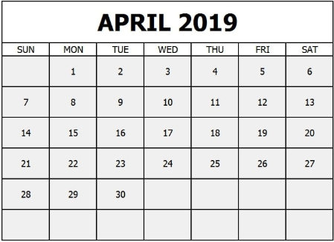
When do I need to update my scholars’ records?
Notes:
Make sure by the deadline of April 5, 2019 you enter/update and submit records for all currently enrolled scholars and scholars who have graduated or exited prior to completion since your last update to the system. You do not need to update records for scholars you have already submitted as graduated or exited prior to completion. In fact, once you have submitted a record for a scholar with a status of graduated/completed or exited prior to completion you will not be able to edit the record. If you need to make any changes to these records please contact the Help Desk.
Make sure you have no scholars in a pending status by the deadline. Scholars cannot be left in a pending status for more than 30 days.
All noncompliant grantees will be reported to OSEP. Project Officers will then contact each project director of grants that have not submitted all scholar data to determine what barriers are preventing the grantee from submitting their scholar data as required and in a timely manner.
According to section 75.217(d)(3)(ii), the Secretary can consider the failure to submit scholar data in a timely fashion in determining your project’s ability to obtain future grants from OSEP or under any other Department program.

Slide 13
Actions to complete in the PDPDCS
Notes:
Transition to grantees’ to do list of all the activities they should be completing by the deadline of April 6th.

Slide 14
Overview of Activities to Complete in the PDPDCS
1
Log into the PDPDCS and verify secondary user
Review your data summary
Add any new scholars
Update Section G
Update Section H
Update Section I
Enter exit information for scholars no longer enrolled (Section J)
Review and submit all data by April 5th deadline
2
3
4
5
6
7
8

Slide 15
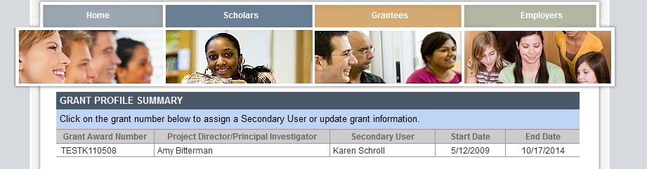
Step : Log into the PDPDCS
1
Log in and review the secondary users assigned to your grant.
Notes:
Set-up a secondary user if you want someone else with the grant to be able to enter scholar information. However, the Project Director is held responsible for all data entries.
Each person should have a unique log in to the system. Do not share your password with anyone – add a secondary user! PDPDCS is governed by Federal security regulations; sharing your password violates those Federal security regulations.
Only two people per grant are permitted access.
Demo how to add or change a secondary user.

Slide 16
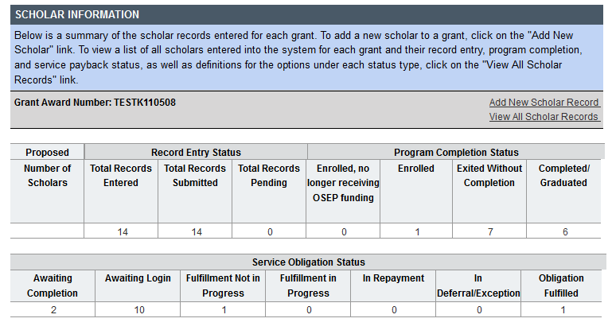
Step : Review your data summary
2
Identify scholars that have not yet logged. Remind scholars to login to the PDPDCS at least every 6 months.
Notes:
Remind scholars to login to PDPDCS at least every 6 months to review and update contact and training information and enter employment. You will be able to monitor the service obligation status of all scholars in your program. Your support will help us ensure OSEP has the data it needs to provide reporting on Program Performance Measures and service obligation results to Federal government authorities
DEMO view all scholar records page with list of all scholars and their service obligation status.

Slide 17
Step : Add new scholars
3
Add records for new scholars not already in the PDPDCS.
Notes:
You should add new scholar records for scholars not already in the system who have been enrolled in the program for 30 days or more. (Demo clicking on “Add New Scholar Record” entering SSN and getting blank Scholar Record to complete.)

Slide 18
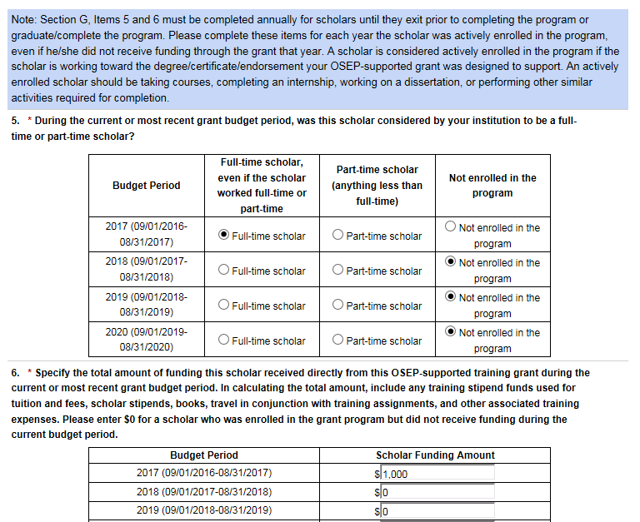
Step : Update Section G
4
Notes:
Demo opening the record of a scholar already entered.
Items 5 and 6 in Section G need to be completed each grant budget year that the scholar is enrolled in the program. The FY in these items refers to your grants fiscal year which is not necessarily the academic year. For example, if your grant fiscal year runs from January to December then you should complete these items based on January 1, 2016 through December 31, 2016. You can find your grant fiscal year in the PDPDCS and the dates of your grant’s FY 2017 were included in the notification email you received last week. If you have any questions about your grant fiscal year please contact the Help Desk.

Slide 19
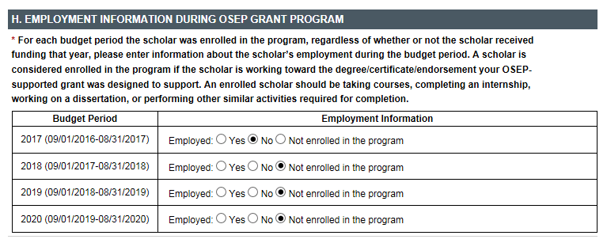
Step : Update Section H
5
Notes:
Section H, information about the scholar’s employment during the grant budget year, also need to be completed each grant budget year that the scholar is enrolled in the program.

Slide 20
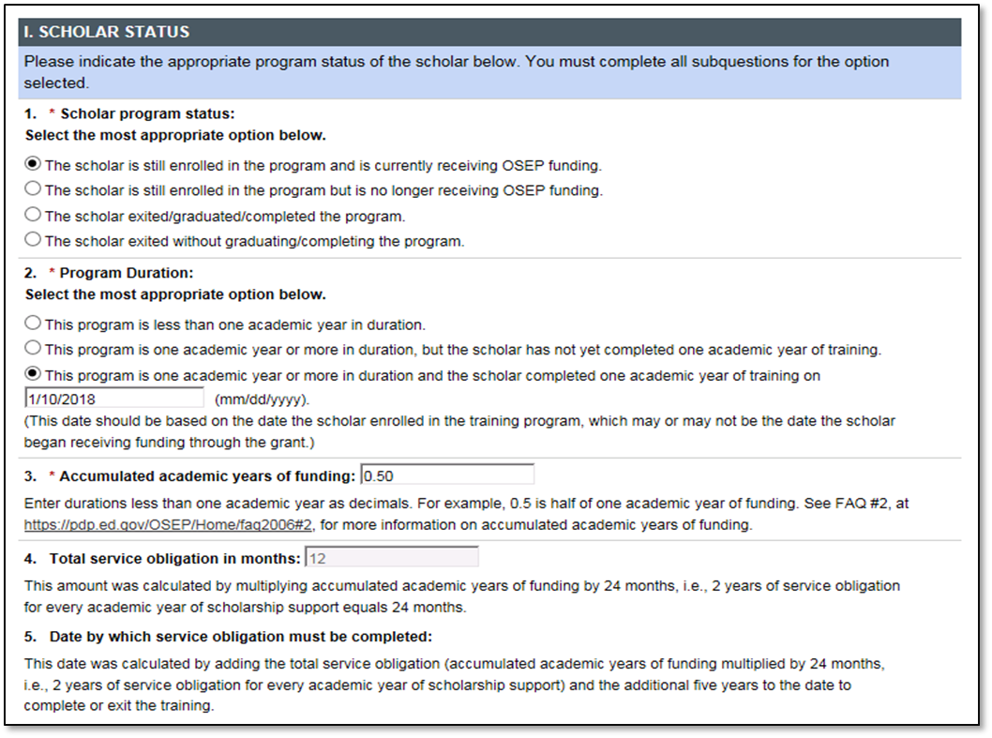
Step : Update Section I
6
Notes:
If scholars are still enrolled you need to update their accumulated academic years of funding in #3 of Section I and once they have completed one academic year make sure to indicate that and enter the date in #2.

Slide 21
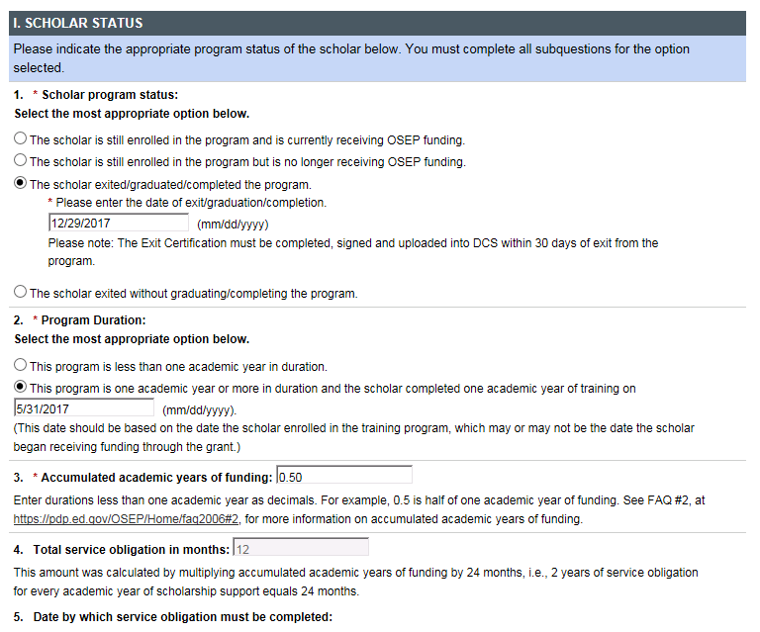
Step : Enter exit information for scholars no longer enrolled
7
Notes:
When a scholar exits the program the grantee must enter the date of exit and upload the completed and signed exit certification. For scholars that complete the program grantees enter the degree earned and the area of the degree. (Demo the items that need to be completed for scholars who exit.) This is particularly important for grants that are closed. All scholars must be in an exited/graduated or exited prior to completion status!

Slide 22
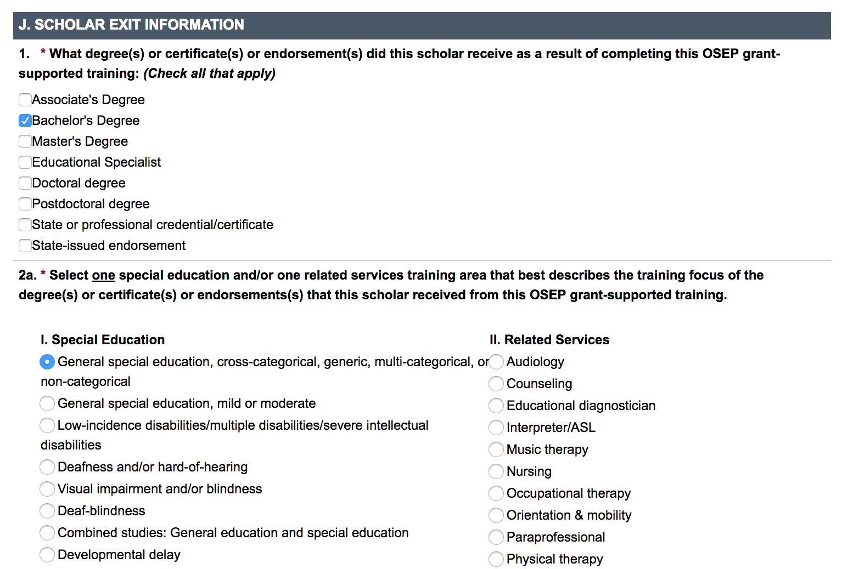
Step : Enter exit information for scholars no longer enrolled
7

Slide 23
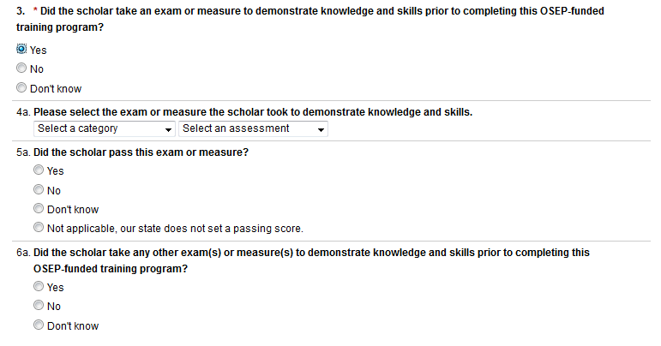
Step : Enter exit information for scholars no longer enrolled
7
Notes:
The priority under which you were funded, requires grantees to identify a measure of knowledge and skills attainment in the grant application. OSEP expects that all project directors will have identified at least one measure of skills and knowledge as part of program completion requirements for scholars. For 7% of scholars (in the FY 2014 data collection), grantees indicated that the scholars have not taken any measures of skills or knowledge or do not know whether the scholars have taken an exam of skills or knowledge. This data is used for one of the program performance measures, so it is critical that you obtain complete information from your scholars about measures of skills and knowledge – what the measure is and whether or not the scholar passed the measure. Notify scholars at the beginning of the program that they will be asked to provide licensure test results, or other exams as required under your priority, and the results will be reported in your data collection. Remember the quality of grantee data influence annual results on program performance measures!
A few important things to remember:
Grantees should note that comprehensive exams, portfolios, practicums, defense of dissertation, thesis and supervisor evaluations are acceptable and are considered grantee specific measures.
In some states, certification or licensure requirements necessitate that scholars take some standardized measures, and grantees can use these measures in their reporting. It is not a requirement if you have another measure.
We continue to have grantees reporting some measures that should not be included. Because we are looking for a measure that is taken towards the end of the scholar’s experience in your program, entrance and preliminary exams are not acceptable. Individual course exams and grades are also not considered to be cumulative enough as a measure.

Slide 24
Step : Submit Data for ALL Scholars by the Deadline
8
Notes:
Make sure by the deadline of April 5, 2019 you enter/update and submit records for all currently enrolled scholars and scholars who have graduated or exited prior to completion since your last update to the system. You do not need to update records for scholars you have already submitted as graduated or exited prior to completion. In fact, once you have submitted a record for a scholar with a status of graduated/completed or exited prior to completion you will not be able to edit the record. If you need to make any changes to these records please contact the Help Desk.
Make sure you have no scholars in a pending status by the deadline. Scholars cannot be left in a pending status for more than 30 days.
All noncompliant grantees will be reported to OSEP. Project Officers will contact then be contacting each project director of grants that have not submitted all scholar data to determine what barriers are preventing the grantee from submitting their scholar data as required and in a timely manner.
According to section 75.217(d)(3)(ii), the Secretary can consider the failure to submit scholar data in a timely fashion in determining your project’s ability to obtain future grants from OSEP or under any other Department program.

Slide 25
Timely Submission
Federal Regulations:
According to 34 CFR 75.253(a)(3), the timely submission of this report is one of the factors that the Secretary will consider in determining whether to continue your project's funding for next fiscal year.
According to section 75.217(d)(3)(ii), the Secretary can consider the failure to submit scholar data in a timely fashion in determining your project’s ability to obtain future grants from the Office of Special Education Programs or under any other Department program.
Notes:
As an OSEP grantee, you are required to submit data for continuation funding and for other reporting, such as performance measures and service obligation. Submitting data on time or the failure to submit data can be considered in determining your ability to obtain future grants not only from OSEP by from other Department programs.
As an OSEP grantee, you are required to submit data for continuation funding and for other reporting, such as performance measures and service obligation. Failure to submit data or submit data on time can be considered in determining your ability to obtain future grants not only from OSEP by from other Department programs.

Slide 26
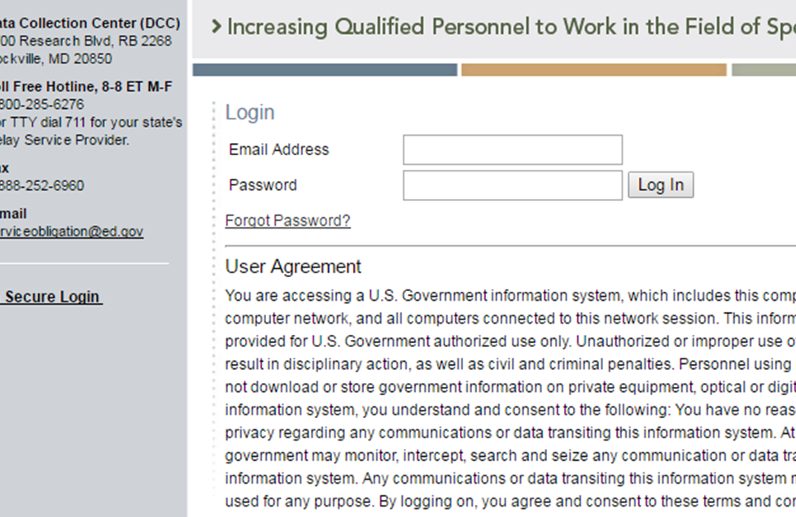
How do I reset my password?
Use the “Forgot Password” link on the login page.
Notes:
**Coming soon: Multi-Factor Authentication**

Slide 27

Why aren’t I (or my scholars) receiving emails from the PDPDCS?
To ensure you and your scholars receive all system notifications:
Add serviceobligation@ed.gov to your contact list
Check your email settings to be sure emails from this account are not marked as spam
Enter a non-IHE email address for each scholar

Slide 28
Why should I add a secondary user?
Project Directors are responsible for all data entries, however secondary users are permitted.
Only two people per grant are permitted access.
Secondary users are given a unique login allowing the to enter scholar information.
Secondary users also receive PDPDCS reminder emails and notifications.

Slide 29
How do I know if my scholars have logged into the PDPDCS?
Notes:
Remind scholars to login to PDPDCS at least every 6 months to review and update contact and training information and enter employment.
You should monitor the service obligation status of all scholars in your program using the summary tables that display counts of scholars in each service obligation status. Your support will help us ensure OSEP has the data it needs to provide reporting on Program Performance Measures and service obligation results to Federal government authorities.

Slide 30
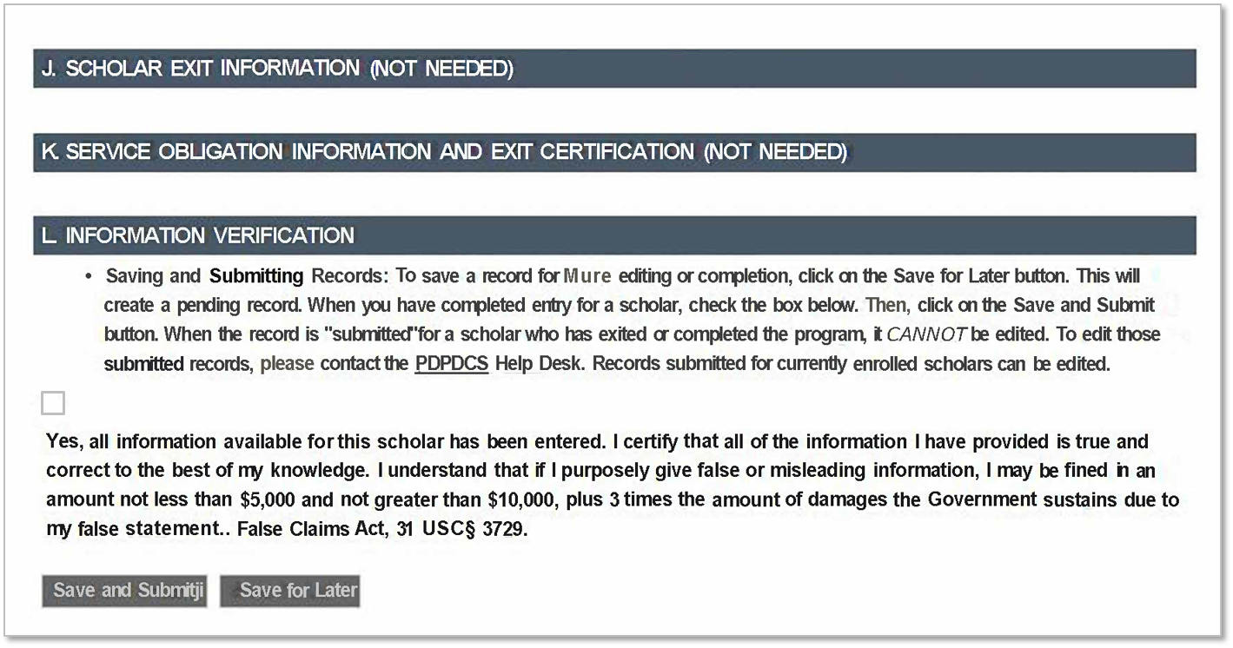
My scholar is still enrolled. Should I submit his/her record?
Notes:
Yes, you should submit all scholar records including scholars who are still enrolled within 30 days of entering the scholar’s record in the system. You will be able to edit your scholar records as long as the scholar has a program status of enrolled.

Slide 31
Changes to the PDPDCS
Notes:
Some changes have been made to the PDPDCS since the data collection period last year.

Slide 32
Changes to the PDPDCS: Emails when Scholars Graduate/Exit
When scholars exit the program (through graduation or exiting without completion), they will receive an email from serviceobligation@ed.gov reminding scholars to log into the PDPDCS and submit eligible employment information.
Increased communication from serviceobligation@ed.gov
More frequent information on steps for scholars to complete in the PDPDCS
Notes:
Some changes have been made to the PDPDCS since last year’s data collection, however the content or method for submitting your data has not change.
Our team has shifted its focus towards improving the usability and reliability of the website.

Slide 33
Upcoming Changes to PDPDCS: Digital Scholar Agreements
Digital versions of the Pre-Scholarship Agreement and Exit Certifications will be available through the PDPDCS later in 2019. Additional information and instructions will be provided.
Notes:
Later in 2019 our team will implement an exciting new enhancement to the website which we hope will drastically increase the accuracy and security of the system’s data, while decreasing the level of effort required for you to create and scholar records and agreements. Our team will implement digital versions of the PSA and EC, rather than PDF or Word versions currently available.

Slide 34
Upcoming Changes to PDPDCS: Digital Scholar Agreements (cont.)
Digital agreements in the PDPDCS will:
Decrease data input burden by auto-populating scholar agreements,
Reduce security issues by eliminating the need to upload documents with PII to the system,
Ensure information within the scholar agreements match that in the scholar record, and
Eliminate need for scanning and uploading agreements (but grantees will still have the option to scan and upload agreements if needed).
Notes:
This enhancement will allow you to input the scholar’s information directly into the PDPDCS which will be used to populate the scholar agreements AND the scholar record. This means you will only have to collect and input the information one time and it will match within the system. These digital agreements will remain in the system (although available for download for your own records), drastically reducing the number of security incidents from uploading incorrect agreements.
Over this past year several project directors have accidentally uploaded the incorrect agreement to a scholar’s record, resulting in a major data security breach, putting the scholar’s PII at risk. This will eliminate that from occurring in the future.
For those of you concerned about the process and how it may intersect with your own university’s agreement procedures, we will still allow you to download, print and upload your scholars’ agreements.
We will provide a more detailed description of the process later in the year. We hope to have the enhancement launched in plenty of time to use with your scholars enrolling in the fall semester.

Slide 35
Changes to the PDPDCS: Multifactor Authentication (MFA)?
MFA is a security process that requires a user to verify their identity in multiple ways to gain system access using your password and an app on your smartphone
PDPDPCS will require the use of MFA:
1/23/2019: Project Directors and Secondary Users
6/15/2019: All Scholars
Employers will not be required to use MFA

Slide 36
Why use MFA for the PDPDCS?
Use of MFA for the PDPDCS greatly reduces the chance of unauthorized access to your account thereby:
Protecting your personally identifiable information (PII), including social security number, home address, and contact information
Significantly reducing the risk of a system-wide data breach

Slide 37
What You Need to Enroll
To enroll in multi-factor authentication for PDPDCS you will need the following:
Your PDPDCS username (email) and password
Device to log into the PDPDCS (a computer, tablet, or other internet-connected device)
A smartphone with iOS or Android (in addition to the device to log into the PDPDCS)

Slide 38


Enrolling in MFA for the PDPDCS
Download and install Google Authenticator on your smartphone
Google Authenticator is free and easy to set up
The app is available through the Apple App Store or Google Play Store by searching for “Google Authenticator”
If you are not sure where to locate the Apple App Store or Google Play Store on your smartphone, look for one of the icons below on your smartphone home screen or within your smartphone’s applications or “apps” section
https://www.apple.com/ios/app-store/
https://play.google.com

Slide 39

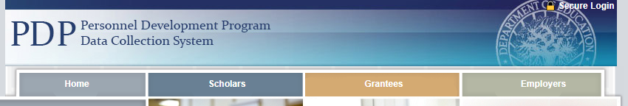
Enrolling in MFA for the PDPDCS
Navigate to the PDPDCS site
On the device you are using to sign into the PDPDCS, navigate to https://pdp.ed.gov/OSEP
On the home page of the site, click Secure Login in the upper right corner

Slide 40
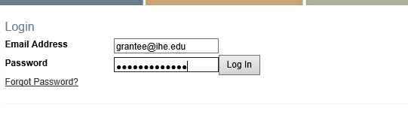
Enrolling in MFA for the PDPDCS
Log into the PDPDCS
Login to the PDPDCS using your regular username and password

Slide 41
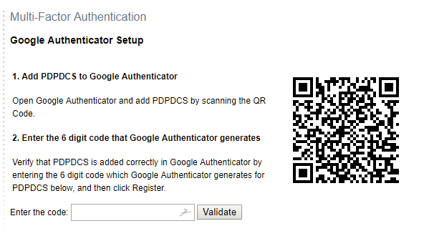
Enrolling in MFA for the PDPDCS
4. Open the enrollment page
When you login, you will be directed to the enrollment page
The enrollment page will include a QR code and a place to enter the code generated by your Google Authenticator app

Slide 42
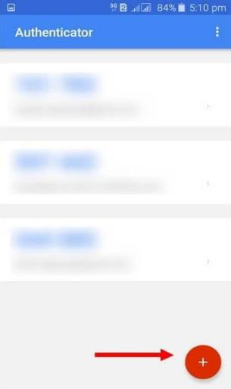
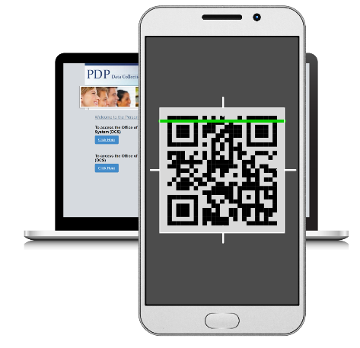
Enrolling in MFA for the PDPDCS
5. Pair the app and PDPDCS
Open the Google Authenticator app on your smartphone
Click the + button on the app to add the PDPDCS website
Scan the QR Code from the PDPDCS website on the enroll page with your cellphone

Slide 43

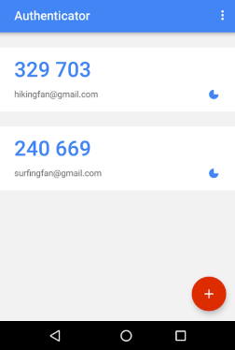
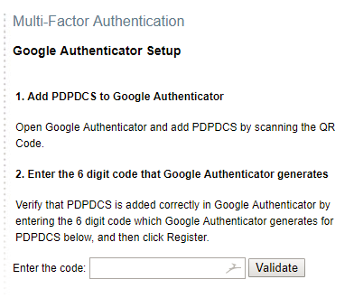
Enrolling in MFA for the PDPDCS
6. Enter code in the app
Enter the code generated by the Google Authenticator app into the PDPDCS enroll page and click “Validate”
Remember to enter the code quickly as each code is only valid for 30 seconds. As soon as another code is generated, the preceding one becomes invalid
6 digit code
Enter code here

Slide 44
Signing into the PDPDCS in the Future
Each time you sign into the PDPDCS from any device you will need to complete these 3 steps:
Enter your username and password in the PDPDCS
Open the Google Authenticator app on your smartphone and take note of the 6 digit security code generated by the app*
Enter the 6 digit security code into the PDPDCS when prompted by the system (prompt will occur after you enter your username and password)
*Remember: Each code is only valid for thirty seconds

Slide 45
MFA Frequently Asked Questions
Am I required to sign up for MFA for the PDPDCS?
Yes, all users will need to set up MFA for the PDPDCS in order to access the system securely.
What do I do if I don’t have a smartphone?
Contact the Help Desk by phone (1-800-285-6276) or email (serviceobligation@ed.gov) and a Help Desk Specialist will assist you.

Slide 46
MFA Frequently Asked Questions (cont.)
What do I do if I’ve downloaded the app and set up MFA, but don’t have my phone with me when I want to sign into the PDPDCS?
Once you have set up MFA for the PDPDCS you must have access to the Google Authenticator app on your smartphone in order to login to the PDPDCS.
What if I forget my password to sign into the PDPDCS?
Go to https://pdp.ed.gov/OSEP, click Secure Login in the upper right corner, enter your email address in the box and then click Forgot Password? directly underneath. A password reset link will be emailed to you.

Slide 47
Resources and Support

Slide 48

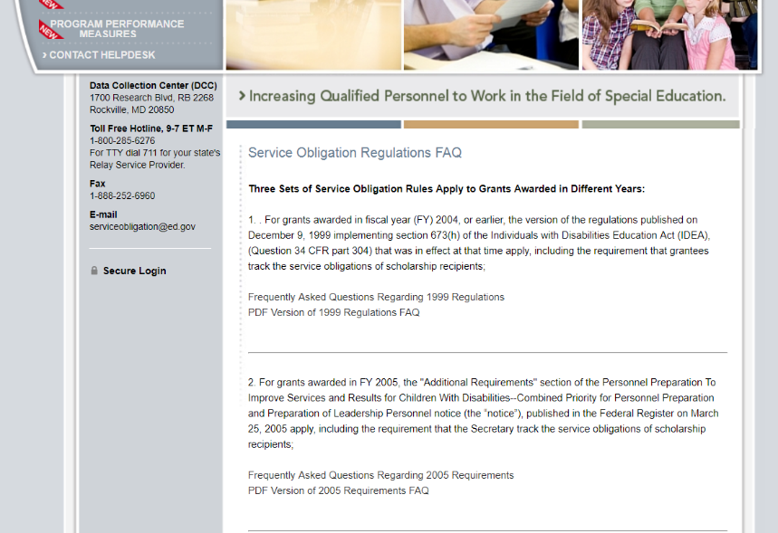
PDPDCS Resources
PDPDCS resources include:
MFA Resources
Training PPT/Video
Enrollment Instructions
(https://pdp.ed.gov/OSEP/Home/Training)
Webinar Recording
(https://pdp.ed.gov/OSEP/Home/Training)
PDPDCS Frequently Asked Questions (https://pdp.ed.gov/OSEP/Home/dcsfaq)
Notes:
A recording of this webinar will be made available on the website for grantees and staff who missed this training or need a refresher. In addition, on the website you can find responses to questions frequently asked by grantees, scholars, and employers regarding program regulations and requirements pertaining to the grant funding, links to service obligation regulations and Pre-scholarship agreements and Exit Certifications. Our Help Desk is available M-F 8 am to 8pm EST via phone or email.

Slide 49
PDPDCS Resources
Service obligation resources for grantees and scholars:
Pre-Scholarship Agreements (PSA) and Exit Certifications (EC) (https://pdp.ed.gov/OSEP/Home/Agreements/)
2006 Service Obligation Regulations (https://pdp.ed.gov/OSEP/Regulation/ProgramRegs2006)
Regulatory Frequently Asked Questions available at: (https://pdp.ed.gov/OSEP/Home/regulatoryfaqs)

Slide 50
Questions and Discussion
More questions?
PDPDCS Help Desk
Support available from 8 am to 8 pm EST
Monday through Friday
1-800-285-6276
For TTY dial 711 for your state’s Relay Service Provider
serviceobligation@ed.gov

Slide 51
Feedback Questionnaire
Please provide feedback on today’s training to improve our support of grantees and scholars:
https://www.surveymonkey.com/r/QZVJP8T

